Slide 1
Build and deployment
October 2017

Slide 2
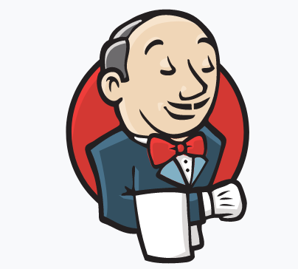
Jenkins
Overview
a self-contained, open source automation server which can be used to automate all sorts of tasks related to building, testing, and deploying software
a simple, extensible, and user-friendly open source tool that provides CI services for application development
can be installed through native system packages, Docker, or even run standalone by any machine with a Java Runtime Environment (JRE) installed

Slide 3
Jenkins
Basic Functionality
Trigger a build
Get source code from repository
Automatically build and test
Generate report and notify
Deploy
Distributed build

Slide 4

maven
Overview
a project management and comprehension tool that provides developers a complete build lifecycle framework. Development team can automate the project's build infrastructure in almost no time as Maven uses a standard directory layout and a default build lifecycle
Maven can manage a project's build, reporting and documentation from a central piece of information

Slide 5
MAVEN
Basic Functionality
Model our software project
Centralize project information
Manage our build process
Gather data about our software project and the build itself
Document the software, and our project

Slide 6

Microsoft build engine (msbuild)
Overview
is the build platform for Microsoft and Visual Studio. The best part of MSBuild is its transparency as to how it processes the builds software which enables the developers to orchestrate the scripts as per the requirements
a build tool that helps automate the process of creating a software product, including compiling the source code, packaging, testing, deployment and creating documentations
a functional replacement for the nmake utility, the latter of which remains in use in projects that originated in older Visual Studio releases

Slide 7
Microsoft build engine (msbuild)
Basic Functionality
develop an application that targets an earlier version of the .NET Framework, for example, versions 2.0, 3.5, or 4
target a framework other than the .NET Framework, for example, the Silverlight Framework.
target a framework profile, which is a predefined subset of a target framework.
If a service pack for the current version of the .NET Framework is released, you could target it.
MSBuild targeting guarantees that an application uses only the functionality that is available in the targeted framework and platform.

Slide 8
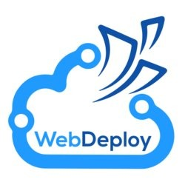
webdeploy
Overview
is an extensible client-server tool for syncing content and configuration to IIS. Web Deploy is used primarily in two scenarios:
1. Developers use it to sync (aka ‘publish') a compiled web applications (ASP .Net, PHP etc) from developer tools (Visual Studio, WebMatrix, etc) to IIS
2. IT professionals use it to migrate websites & applications from an operating system running an older version of IIS such as IIS6 to an operating system running a newer version of IIS such as IIS 7.5.

Slide 9
webdeploy
Basic Functionality
Seamless integration with IIS Manager, Visual Studio for creating packages and deploying them onto a machine, both locally and remotely.
Seamless integration with the Web Platform Installer to install community web applications simply and easily.
Web application packaging:
Ability to package a Web application or an entire site, including the associated databases.
Ability to package ACLs, COM, GAC and registry settings.
Supports both live servers and zipped packages as a source or destination.

Slide 10
webdeploy
Basic Functionality
Web application deployment:
Administrative privileges are not required in order to deploy Web applications.
Ability to add powerful parameters to change text in files when they are deployed (such as prompting to replace a connection string when deploying from QA to staging environments).
Integration with the IIS Web Management Service (WMSVC) for remote deployment by non-administrators.
Server administrators have granular control over the operations that can be performed and can delegate tasks to non-administrators.

Slide 11
webdeploy
Basic Functionality
Web server migration and synchronization:
Ability to synchronize or migrate the entire Web server, a Web site or application.
Synchronizes only the data that has changed.
Ability to detect missing dependencies during synchronization.
Automatically gathers content, IIS configuration, SSL certificates and ASP.NET configuration when you sync a Web site.
Automatic backup of Web Sites before making any changes.
Administrator can configure Web Deploy such that it creates and store backup of websites on the server.
End users can directly restore their websites without admins involvement.
In addition to the IIS Manager and Visual Studio, tasks can be performed using the command-line, PowerShell Cmdlets or public APIs.

Slide 12

chef
Overview
a powerful automation platform that transforms infrastructure into code. Whether you’re operating in the cloud, on-premises, or in a hybrid environment, Chef automates how infrastructure is configured, deployed, and managed across your network, no matter its size.

Slide 13
chef
Basic Functionality
Analytics
Backup and recover
Dynamic policies
Real-time data
Scalable automation
Software and infrastructure changes
Test deployment reliability
Reports on compliance issues and security risks
Reports on out of date software
Classify by severity
Build security and compliance checks
Scan entire infrastructures
Pre-built profiles for CIS, Linux and Windows
Query, visualize, and report on operational events
Notifications across multiple platforms
Generate reports
High availability solution on-premise or in the cloud
Deliver latest tested/approved policies to infrastructure
Automation for flexible IT
Search-based configuration
Continuous delivery for applications and infrastructure
Code review and automated testing
Server performance

Slide 14
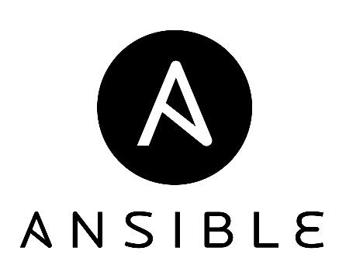
ansible
Overview
a radically simple IT automation engine that automates cloud provisioning, configuration management, application deployment, intra-service orchestration, and many other IT needs
an open source automation platform
can help you with configuration management, application deployment, task automation
can do IT orchestration, where you have to run tasks in sequence and create a chain of events which must happen on several different servers or devices

Slide 15
ansible
Basic Functionality
automating remote system provisioning and applications deployment
with no agents to install on remote systems
using existing SSHd on remote system
native OpenSSH for remote communication on control machine
parallel by default
automation language that approaches plain english

